Slide 1
Intro to HTTP and Web Servers
CodeBreak Winter 2016

Slide 2
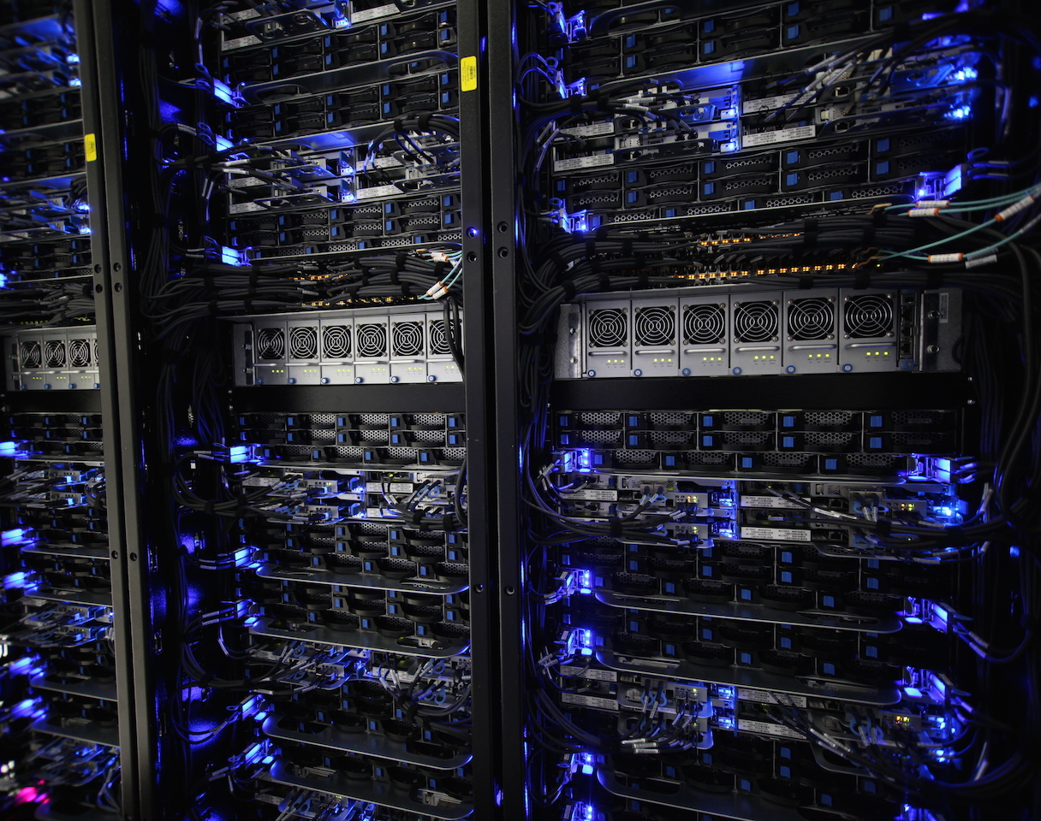
“Server”
Probably magic, right?
(Picture: DarkSoul)

Slide 3
Servers aren’t magic.
Something that provides services for other computers (“clients”)
Just a program
“Provides services” is very generic
Computer meant for only running server programs = “server”
Programs themselves are the server

Slide 4
“Protocol”
An agreed-upon way of exchanging information
Something that follows specifications

Slide 5
HTTP = Hyper Text Transport Protocol
A “protocol” for loading things on the web
(HTTPS = HTTP, but encrypted)

Slide 6
Example HTTP Request
Request (Client to Server)
Response (Server to Client)
GET /test.html HTTP/1.1 Host: tyler.vc
HTTP/1.1 200 OK Content-Length: 88 Content-Type: text/html Connection: Closed <html> <body> <h1>Hello, World!</h1> </body> </html>

Slide 7
“404”
Request (Client to Server)
Response (Server to Client)
GET /test2.html HTTP/1.1 Host: tyler.vc
HTTP/1.1 404 File Not Found Content-Length: 89 Content-Type: text/html Connection: Closed <html> <body> <h1>File Not Found</h1> </body> </html>

Slide 8
“POST”
Request (Client to Server)
Response (Server to Client)
POST /test3.php HTTP/1.1 Host: tyler.vc parameter=value&also=another
HTTP/1.1 302 Found Content-Length: 0 Content-Type: text/html Connection: Closed Location: http://tyler.vc/ok.html

Slide 9
What the Server Does
Request (Client to Server)
Web Server Pseudo-Code
GET /test.html HTTP/1.1 Host: tyler.vc
Read the request, get the file name and host
Read the config file, find the section for host
Look for the file name from the request in the directory from the config file
Return the text for that
Config: /etc/apache2/httpd.conf
<VirtualHost *:80> DocumentRoot /var/www ServerName tyler.vc </VirtualHost>
/var/www
-test.html -test3.php -me.jpg

Slide 10
Files Are Not Necessary!
HTTP is just text!
We can code it however we want, as long as we “speak” HTTP

Slide 11
Web Servers

